Slide 1

Design and Implementation of an Automated Sorting System Using Mechatronics Principles

Slide 2

Introduction to Automated Sorting
Traditional manual sorting methods are often slow and error-prone. They require significant labor. Integrating mechatronics principles can streamline operations.
Automated sorting reduces human intervention. It enhances efficiency in various applications, using sensors, actuators, and controllers.
Reduced Errors
Increased Speed
Automated systems minimize manual errors.
Sorting is completed faster than manual.
Lower Labor Costs
Reduced need for manual labor.

Slide 3
Hardware and Software Components
The automated system integrates specific hardware and software components for effective sorting. These components work together to detect, process, and sort objects.
Hardware Components
Software Components
Metal sensors
Python language
Servo motors
STM 32 controller

Slide 4




Sorting Procedure
The automated sorting system follows a structured process. This process ensures accurate and efficient sorting of objects based on material and color.
Object Placement
Place object on conveyor belt
Color Sorting
Color sensor detects object color
Final Sorting
Sorting arm moves object to correct bucket

Slide 5
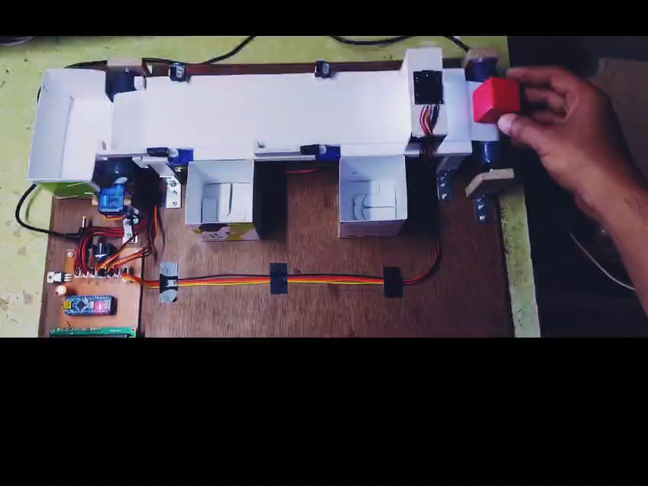
Model Working

Slide 6





Outcomes of Automation
Implementing an automated sorting system yields several key benefits. These outcomes improve operational efficiency and overall productivity.
Increased Efficiency
Higher Accuracy
Minimal Human Intervention
Scalability

Slide 7

Future Scope and Expansion
The potential for expanding the automated sorting system is significant. Future developments can enhance functionality and applicability.
1
AI Integration
Use AI for object recognition
2
Improved Sensors
Enhance sensor accuracy
3
Scalability
Expand system for larger operations

Slide 8
Thank You

